Slide 1
ENGINEERING ECONOMICS PROJECT INNOVATIVE PROJECT HOW ENGINEERING CAN HELP IMPROVE LIVES AT SLUM Submitted by : PRAJJWAL CHITTORI (2K18/CO/249) PRANAV ROY (2K18/CO/250) (Dept. of Computer Science and Engineering)

Slide 2
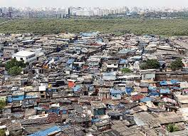
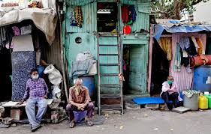
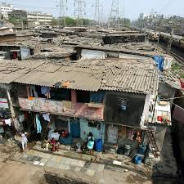
INTRODUCTION
Engineering is a branch of Science that applies the scientific phenomena and logic to solve real world problems. It is basically the implementation of scientific concepts to build and design some entity.
The discipline of engineering encompasses a broad range of more specialized fields of engineering, each with a more specific emphasis on particular areas of applied mathematics, applied science, and types of application.
A slum is usually a highly populated urban residential area consisting mostly of closely packed, decrepit housing units in a situation of deteriorated or incomplete infrastructure, inhabited primarily by impoverished persons. Slums are usually located in urban and suburban areas where housing quality is low and living conditions are poor.

Slide 3
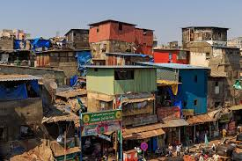
INTRODUCTION
While slums differ in size and other characteristics, most lack reliable sanitation services, supply of clean water, reliable electricity, law enforcement, and other basic services. Slums are still predominantly found in urban regions of developing countries, but are also still found in developed economies.
This project aims to identify various ways in which Engineering (particularly Computer Science and Engineering) can be used to help improve daily lives at slums and in low income neighbourhoods.

Slide 4
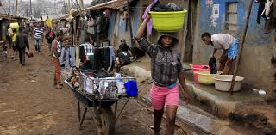
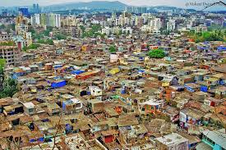
This project aims to identify various ways in which Engineering (particularly Computer Science and Engineering) can be used to help improve daily lives at slums and in low income neighbourhoods.

Slide 5
PROBLEMS AT SLUMS:
We should first look at the various problems and deficiencies that people living in slums face. These problems include :
Irregular Electricity supply
Unhygienic water supply
Lack of Sanitation and cleanliness
Unavailability of teachers and resources at government schools
Lack of proper health centers.
Inefficient implementation of government policies like PDS(food distribution for people below poverty line) and proper housing.
Increased crime rates and poor law enforcement.

Slide 6
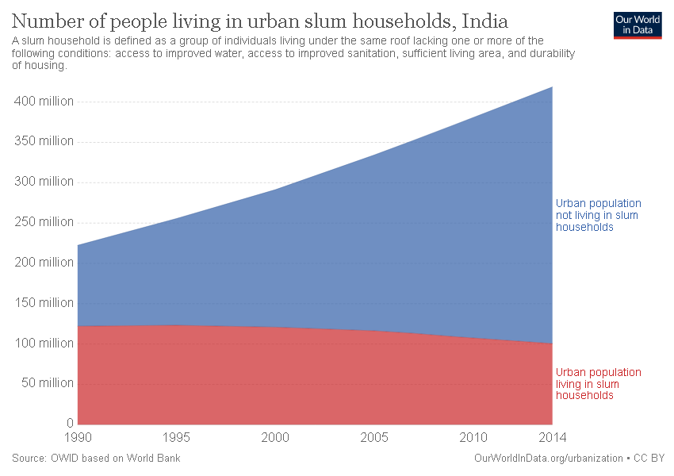

Slide 7
SOLUTIONS:
We should follow a realistic approach while helping tackle their problems. We would start by some very basic amenities like Food, Water etc.
FOOD
We know that the majority of the people who live in slums are below the poverty line and thus they are eligible for benefits from Government schemes like PDS(Public Distribution System). Under this scheme, food grains and other eatables like sugar, oils and spices are provided to people at very low prices. But the distribution is not always very efficient and partial. Many times the government representative responsible for distribution provides a lesser amount of food grains to people than what they are entitled to. Records of distribution are also done manually and hence there always is a scope of tampering the data and mismanagement of records.

Slide 8
We propose to introduce, with due permissions from local authorities, a Computerised system for record-keeping at such distribution outlets. Databases are very efficient tools to store, retrieve and update data and there will be a minimal chance of error or tampering of data. It would also create an employment opportunity as an operator would be needed to feed the entries of distribution into the database. Along with the introduction of Database there should also be a watchdog(system administrator) that ensures proper distribution.

Slide 9
EDUCATION
Government schools at slums are mostly in poor
conditions. There is a scarcity of even basic teaching infrastructure at these
schools and there are not enough teachers to teach students.
Consequently, students lose interest in studies and the majority of them
drop out before high school. And such uneducated and unemployed
children/youths turn towards criminal activities.
We propose to introduce a system where teaching and learning would
mostly be done from smartphones (since they have become very common
in slums also and also keeping in mind the current pandemic).
We can develop an application to provide study materials and test
papers to students of various classes. There is internet connectivity in
slums too nowadays, therefore it must not be very difficult for students to
access study materials and assignments of various subjects through
the mobile application.

Slide 10
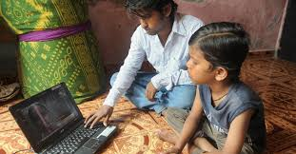
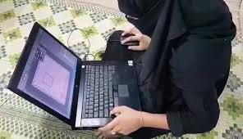
Annual examinations for students shall be conducted in schools while maintaining proper social distancing and other COVID protocols. This initiative can improve the state of education and learning for students living in slums.

Slide 11
GRIEVANCES REDRESSAL SYSTEM
We understand that there are abundant problems faced by the slum population and some can only be solved by Government or local authorities itself. We would require a healthy cooperation from government agencies for solving issues like irregular and unhygienic water supply and sanitation.
We propose to introduce a Complaint Redressal System that will aim to help register the complaints of people regarding various issues like sanitation facilities, water supply and electricity supply.

Slide 12

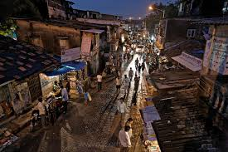
With the help of the government we can build and design a web application that will be accessible to every person in slum. They can register whatever issues they face in the form of a complaint. All the entries/complaints would be communicated to government authorities and they would take proper measures to solve the problems.

Slide 13
SKILL DEVELOPMENT OF YOUTHS
We are aware of the fact that many of the adolescents and young adults in slums do not have proper and enough education to enable themselves to get respectable jobs. In
absence of proper opportunities, they turn towards criminal activities. This is a very serious concern and it causes a higher rate of crimes than usual and disturbs law enforcement.
If these people are trained or upskilled in some crafts/discipline then they will be able to find jobs and earn a livelihood for themselves.

Slide 14
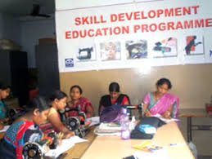
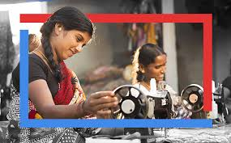
We, again with cooperation of local authorities, would propose to organize a skill development camp through which we would teach people the basic computer knowledge. We would teach them how to use basic computer softwares like Word, Excel, Power-Point and Emails and File Transfers etc.

Slide 15
CONCLUSION
We applied a hands-on approach towards solving some of the problems that people in slums face on a daily basis. We identified the areas where there was a scope for implementing engineering knowledge to help improve the lifestyle of people. We talked about education, food distribution and skill development of youths and improving law enforcement.

Slide 16
CONCLUSION
There still are some issues left like healthcare, sanitation and water supply that can not be solely solved by engineering aid. These problems require governmental interference and resources and extensive planning. Therefore, we suggest that Government and Local authorities work in tandem with a group of engineers, teachers and doctors and Police personnel to tackle the problems that the population of slums face.

Slide 17
REFERENCES
WIKIPEDIA (https://en.wikipedia.org/wiki/Slum)
GOOGLE IMAGES
https://www.habitatforhumanity.org.uk/
https://www.sciencedirect.com/topics/social-sciences/slums
https://www.citiesalliance.org/about-slum-upgrading
https://www.engineering.com/
https://www.shiksha.com/engineering-chp
https://smartcitiescouncil.com/article/can-technology-improve-lives-urban-slums-6-examples-suggest-yes-it-can
https://thelogicalindian.com/my-social-responsibility/community-leadership-programmes/
https://www.quora.com/How-can-we-improve-slums-life-using-engineering

Slide 18
Thanks!
Any questions?
You can find me at:
Prajjwal
prajjwalchittori1@gmail.com
Pranav
pranavroy2001@gmail.com

